Slide 1
Docker: Containerization Simplified
Understanding Docker's Role in Modern DevOps

Slide 2
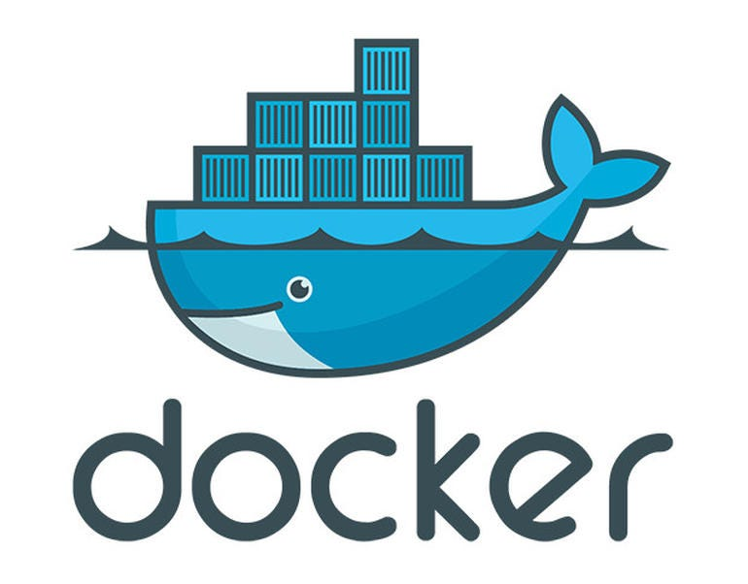
What is Docker?
Docker is a platform for developing, shipping, and running applications inside lightweight, portable containers.
Containers package an application and its dependencies into a single unit that can run anywhere.
Unlike VMs, Docker containers share the host OS kernel, making them more lightweight and efficient.

Slide 3
Key Components of Docker
Docker Engine: The core component that runs Docker containers.
Images: Read-only templates used to create containers.
Containers: The running instances of Docker images that can interact with other services.
Docker Hub: A registry of Docker images, where you can download and upload images.
Docker Compose: A tool for defining and running multi-container Docker applications.

Slide 4
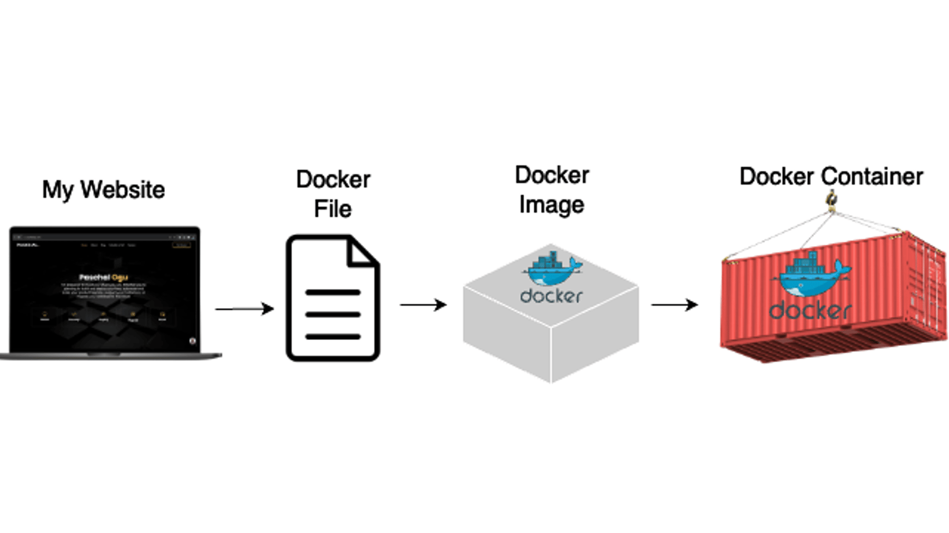

Slide 5
Docker Architecture
1.Client-Server Architecture:
Docker Client: Users interact with the Docker client to issue commands (e.g., docker run).
Docker Daemon: The Docker Daemon runs in the background, managing containers and images.
2.Docker Registries: Docker images are stored in registries such as Docker Hub or private registries.
3.Communication: The Docker client communicates with the Docker daemon via REST API or UNIX sockets.

Slide 6
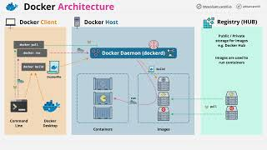

Slide 7
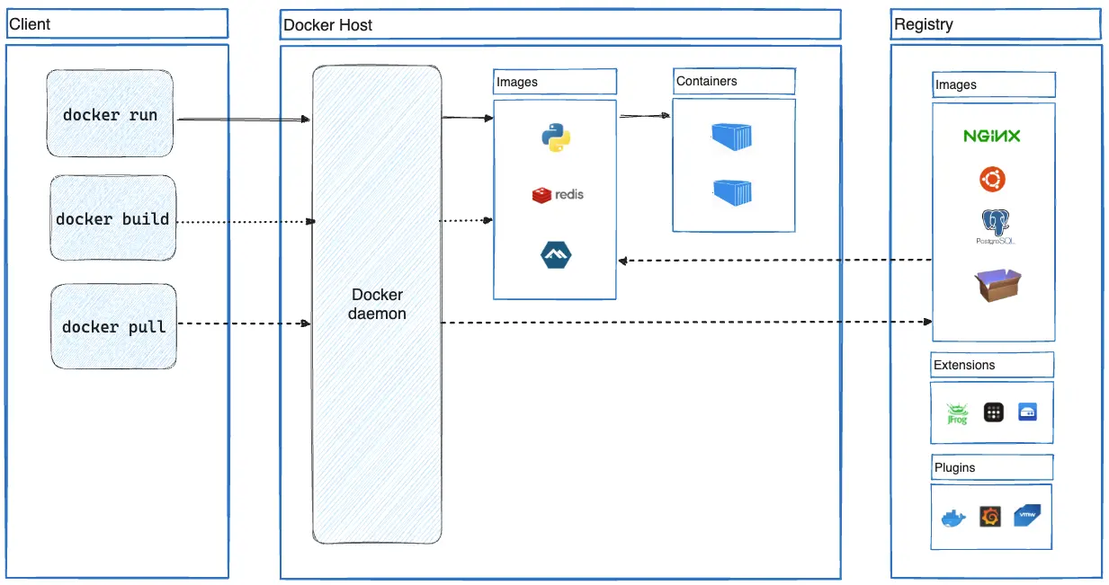

Slide 8
How Docker Works
Build Process: Docker uses Dockerfiles to automate the process of building images.
Run Process: Containers are run from images, which include the application and its dependencies.
Isolation: Containers isolate processes from each other and from the host system, ensuring consistency across environments.
Networking: Docker provides networking features to link containers together and manage their communication.

Slide 9
Docker Commands
docker build: Build an image from a Dockerfile
docker run: Run a container from an image
docker ps: List running containers
docker stop: Stop a running container
docker pull: Download an image from Docker Hub
docker exec: Execute a command inside a running container

Slide 10
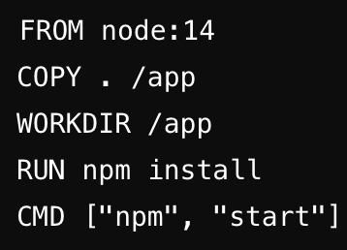
Dockerfile Basics
Dockerfile: A text file containing instructions on how to build a Docker image.
Basic Syntax:
FROM: Specifies the base image
RUN: Executes commands inside the container
COPY: Copies files into the container
CMD: Specifies the command to run when the container starts

Slide 11
Docker Images and Layers
Image Layers: Docker images are built in layers. Each layer represents a change made to the image.
Layer Caching: Docker caches layers to speed up image builds by reusing layers that haven't changed.
Image Size: Smaller images lead to faster deployments and less overhead.
Optimizing Dockerfiles: Combining commands and minimizing layers helps reduce image size.

Slide 12
Docker Networking
Network Types:
Bridge Network: Default network for containers on the same host.
Host Network: The container shares the host’s network stack.
None Network: No networking for the container.
Overlay Network: For multi-host networking in Docker Swarm or Kubernetes.
Port Mapping: Expose container ports to communicate with external applications.

Slide 13
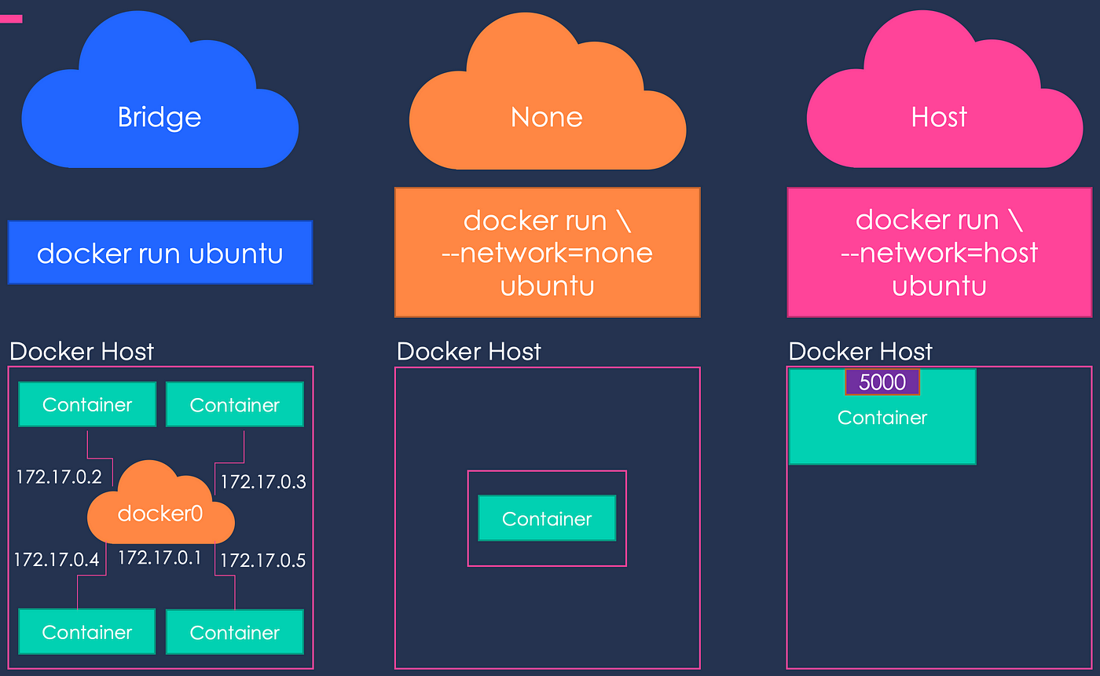

Slide 14
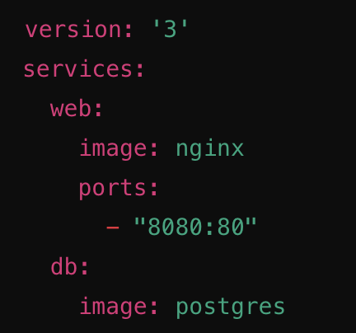
Docker Compose
What is Docker Compose?: A tool for defining and running multi-container Docker applications.
docker-compose.yml: The configuration file where you define services, networks, and volumes.
Common Commands:
docker-compose up: Starts all services defined in the Compose file
docker-compose down: Stops all services and removes containers

Slide 15
Docker in DevOps and CI/CD
DevOps and Docker: Docker helps streamline the development pipeline by providing consistent environments from development to production.
Continuous Integration (CI): Build, test, and deploy Docker images as part of the CI pipeline.
Continuous Deployment (CD): Automate the deployment of Docker containers to production environments.
Popular CI/CD Tools: Jenkins, GitLab CI, CircleCI, and GitHub Actions.

Slide 16
Best Practices for Docker
Keep Images Small: Use minimal base images to reduce overhead.
Use Multi-stage Builds: Separate the build and runtime environments to optimize image size.
Limit Container Privileges: Use Docker’s security features to limit access and reduce vulnerabilities.
Monitor and Log: Use tools like Docker stats and logging drivers to monitor containers.

